Slide 1
Northumbria University
RestorativeJustCulture
#TakeOnTomorrow

Slide 2
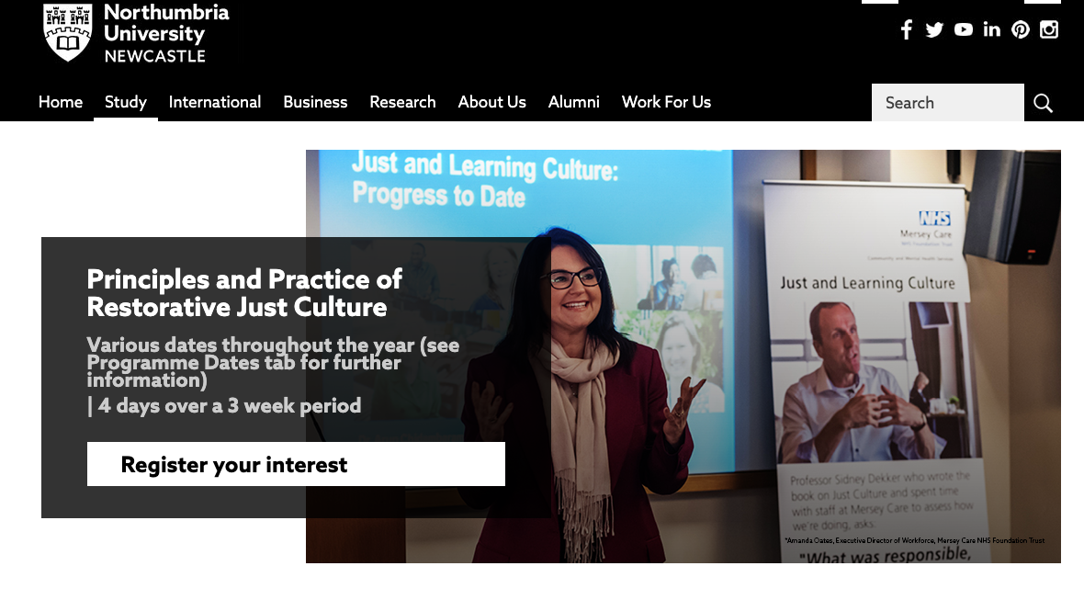

Slide 3


Slide 4


Slide 5
